Slide 1
IT 1107 Mathematics for IT
Week 1 - Introduction to Sets

Slide 2
Module Data
GPA
2 Credits
15 Hours-Lectures
30 Hours-Tutorials

Slide 3
Aim & Objectives
To introduce set theory and their algebraic relationships
To introduce matrices and algebraic relationships and to enable the students to understand multidimensional representation of data and information
To provide core knowledge of Mathematics as a background in advanced topics such as Graphics &
Multimedia, Probability & Statistics
To guide students to apply appropriate mathematical knowledge and skills towards solving problems that are beyond ordinary coursework

Slide 4
Learning Outcomes
At the end of the module the student will be able to:
Construct Sets and describe basic set operations
Describe and use algebraic operations in Sets
Identify relations and functions
Examine the characteristics of relations and functions
Describe the matrices and apply basic algebraic operations on matrices
Solve systems of linear equations using matrices

Slide 5
Outline Syllabus
Sets and basic Set operations
Construction of Sets
Algebra of relations
Introduction to Functions
Types of Functions
Matrices and basic matrix operations
Singularity and Determinants
Systems of linear equations

Slide 6
Assessment & weighting
Continuous assessment
In class assignments, quizzes, take home assignments and tutorials- 50%
End Semester Examination
Structure Exam Paper- 50 %

Slide 7
References
Discrete Mathematics 6th ed. - Richard Johnsonbaugh
Macmillan. ISBN 0-13-045803-1
The Joy of Sets (2nd ed.) - Keith Devlin Springer Verlag, ISBN 0-387-94094-4
Online Resources:
http://www.sosmath.com

Slide 8
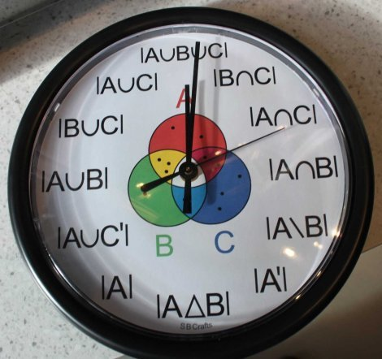
Introduction to Sets

Slide 9
Objectives
At the end of this chapter, students should be able to:
Construct Sets and describe basic set operations

Slide 10
Definition of set
A set is an unordered collection of zero or more distinct well defined objects
Eg:
A = {1,2,3}
B = {Numbers less than 10}
C = {All the positive numbers}

Slide 11
Properties of Sets
Sets are inherently unordered
The order in which the elements are presented in a set is not important
A = {a,e,i,o,u} and
B = { i,o,a,u,e} both define the same set
All elements are distinct (unequal)
One member does not appear more than once
F = {a,e,i,o,u,a} is not a set since the element ‘a’ repeats

Slide 12
Set Theory Notations
Symbol | Meaning | Example
Upper case | Designates set name | A={1,2,3}
Lower case | Designates set elements | A={a,b,c}
{ } | a collection of elements | A = {3,7,9,14}, B = {9,14,28}
∈ or ∉ | Is / is not an element of | A={1,2,3} 5 ∉ A 1 ∈ A
⊆ | Is a subset of(includes equal sets) | {9,14,28} ⊆ {9,14,28} {9,14} ⊆ {9,14,28}
⊂ | Is a proper subset of | {9,14} ⊂ {9,14,28} {9,14,28} ⊄ {9,14,28}
⊄ | left set not a subset of right set | {9,66} ⊄ {9,14,28}

Slide 13
Elements
The items contained in a set are called elements or members of the set
Notation
∈ means “is an element of”
∉ means “not an element of”
Eg: S ={ x,y,z}
x ∈ S
p ∉ S

Slide 14
Sub Set
If every element of set A is also contained in set B then set A is a subset of set B
“A” is contained in “B” or “B” contains “A”
It is denoted by A ⊆ B or B ⊇ A
C
A = {1,3}
C = {1,3,5,7,9}
A A ⊆ C
7
9
1
3

Slide 15
Proper subset
A proper subset of a set A is a subset of A that is not equal to A.
In other words, if B is a proper subset of A, then all elements of B are in A but A contains at least one element that is not in B.
It is denoted by B ⊂ A

Slide 16
Eg: A={1,3,5}
B={1,5}
C={1,3,5}
D={1,4} then
B ⊂ A
C ⊄ A but C ⊆ A
D ⊄ A and D ⊄ A

Slide 17
Specifying set
There are 2 ways to specify a set
Listing notation
List all the members of the set
Eg: A = {a,e,i,o,u}
Set builder notation
State those properties which characterized the members in the set
Eg: B = { x : x is an even integer , x>0}

Slide 18
Some common sets
Z
Z is the set of all integers
Z = { ……,-2,-1,0,1,2,……}
Z⁺ - the set of positive integers
Z⁻ - the set of negative integers
N
Set of natural numbers
N = {1,2,3,…..}

Slide 19

Q
Set of rational numbers
Q = {$\frac{a}{b}$ : a,b integers , b≠0}
Q⁺ - Set of positive rational numbers
Q* - Set of non zero rational numbers

Slide 20
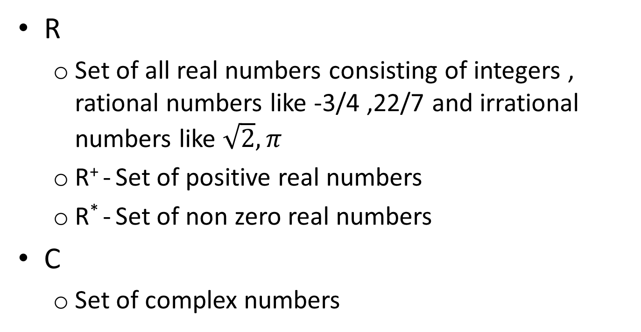
R
Set of all real numbers consisting of integers , rational numbers like -3/4 ,22/7 and irrational numbers like $\sqrt{2}, π$
R⁺ - Set of positive real numbers
R* - Set of non zero real numbers
C
Set of complex numbers

Slide 21
Equality of two sets
A set “A” is equal to a set “B” if and only if both sets have same elements
If set “A” and “B” are equal we write A=B
Eg: A = {1,2,3,4,5}
B = { x : x< 6 , x∈ Z⁺}
C = {1,2,3,4}
Then A=B and A≠C

Slide 22
Cardinality of sets
Cardinality refers to number of elements in a set
Let “A” be any set. Then cardinality of “A” is denoted by |A|
Eg: A = {a,e,i,o,u}
then |A| = 5

Slide 23
Power set (P)
The power set is the set of all subsets that can be created from a given set
If |A|=n then |P(A)|=2^{n}
Eg: A ={1,2,3} where |A|=3
|P(A)|=2³ = 8
P(A)= {φ , {1},{2},{3},{1,2},{1,3},{2,3},{1,2,3}}

